Slide 1
VACCINE TRACKING - TRANSPARENT
BY,
MOHANKUMAR S
ELANGKUMARAN T
GNANAMOORTHI M
NAVEENKUMAR M

Slide 2
ABSTRACT
Vaccine Tracking Transparent is a blockchain-based platform that is designed to provide a secure and transparent way to track and trace vaccines from their source to their destination. The platform will allow for a secure and auditable record of vaccine production, distribution, and administration, helping to ensure the highest standards for vaccine safety and efficiancy. The blockchain technology also provides an immutable record of the vaccine’s lifecycle, enabling stakeholders to trace the movement and administration of vaccines in real-time.This project aims to use blockchain technology to create a transparent and secure vaccine tracking system.

Slide 3
PROBLEM STATEMENT
Ensuring transparent vaccine tracking is crucial for building public trust and effectively managing vaccine distribution. The current lack of a unified, real-time tracking system results in information silos, potential vaccine wastage, and difficulty in monitoring the vaccine supply chain.

Slide 4
OUR SOLUTION
Implement a blockchain-based vaccine tracking system that securely records every vaccine's journey from production to administration. This decentralized ledger technology ensures data integrity, transparency, and immutability, allowing healthcare authorities, providers, and the public to access real-time information on vaccine distribution, availability, and quality control. This transparency enhances accountability, reduces the risk of counterfeits, and ensures efficient vaccine deployment, ultimately bolstering public confidence in vaccination efforts.

Slide 5
SCOPE OF THE PROJECT
The scope of the project for vaccine tracking transparency encompasses the development of a comprehensive and secure digital platform that enables real-time monitoring, tracing, and verification of vaccine distribution and administration. This system will incorporate blockchain technology to ensure data integrity and transparency, providing a reliable record of each vaccine's journey from production to injection. It will offer stakeholders, including healthcare providers, government agencies, and the public, access to verifiable information on vaccine availability. utilization, and efficacy. The project aims to enhance public trust in vaccination programs and facilitate rapid response to supply chain issues, ultimately contributing to global health and safety.

Slide 6
STEPS TO COMPLETE THE PROJECT
Step 1:-
Open the Zip file and download the zip file. Extract all zip files
Step 2 :
1.Open vs code in the left top select open folder. Select extracted file and open .
2. Select the projectname.sol file and copy the code.
3. Open the remix ide platform and create a new file by giving the name of projectname.sol and paste the code which you copied from vs code.
4. Click on solidity compiler and click compile the projectname.sol
5. Deploy the smart contract by clicking on the deploy and run transaction.
6. select injected provider - MetaMask. In environment
7. Click on deploy. Automatically MetaMask will open and give confirmation.

Slide 7
8. In the Deployed contract you can see one address copy the address.
9. Open vs code and search for the connector.js. In contract.js you can paste the address at the bottom of the code. In export const address.
10. Save the code.
Step 3:
open file explorer
1. Open the extracted file and click on the folder.
2. Open src, and search for utiles.
3. You can see the frontend files. Select all the things at the top in the search bar by clicking alt+ A. Search for cmd
4. Open cmd enter commands npm install npm bootstrap npm start
5. It will install all the packages and after completing it will open {LOCALHOST IP ADDRESS} copy the address and open it to chrome so you can see the frontend of your project.

Slide 8
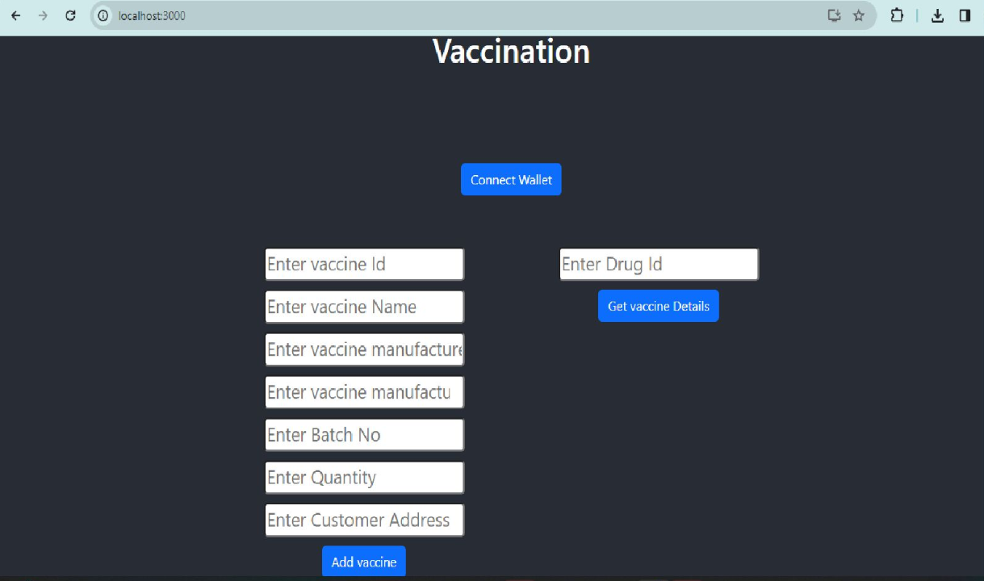
OUTPUT

Slide 9
CONCLUSION
In conclusion, establishing a transparent vaccine tracking system is crucial to ensure the efficient distribution and monitoring of vaccines, especially in the context of global health crises. By addressing the problem of vaccine distribution inefficiencies and opacity, the proposed solution not only enhances accountability but also fosters public trust. The scope of this project encompasses the development of a comprehensive, blockchain-based tracking system that provides real-time data on vaccine manufacturing, distribution, and administration. To complete the project, we will follow a systematic approach, including system design, development, testing, and deployment. Ultimately, this initiative holds the potential to revolutionize the healthcare sector by ensuring equitable access to vaccines and enhancing global health security.

Slide 10
THANK YOU !!!

